Slide 1

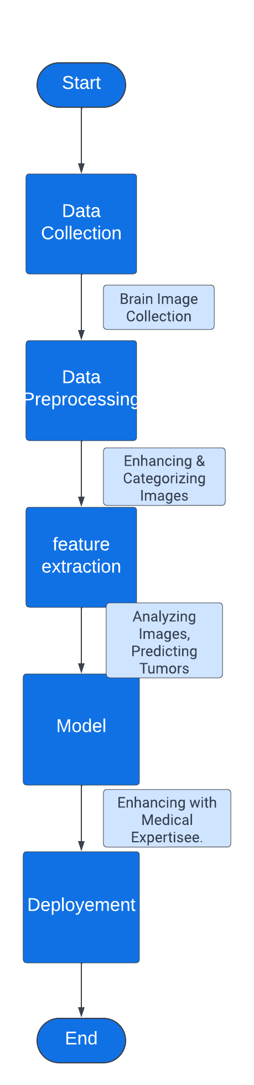
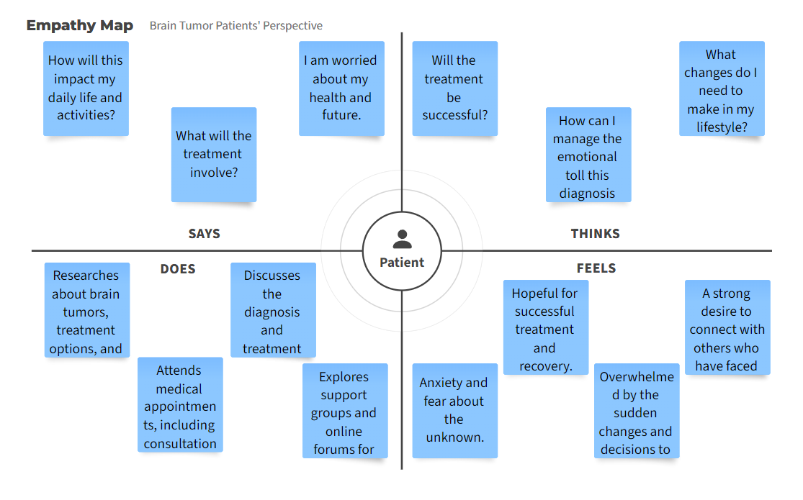
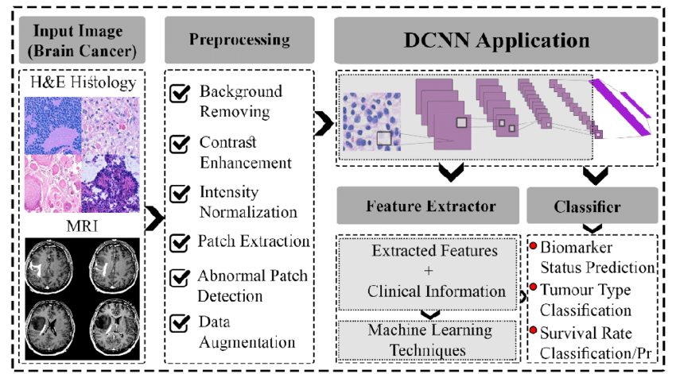
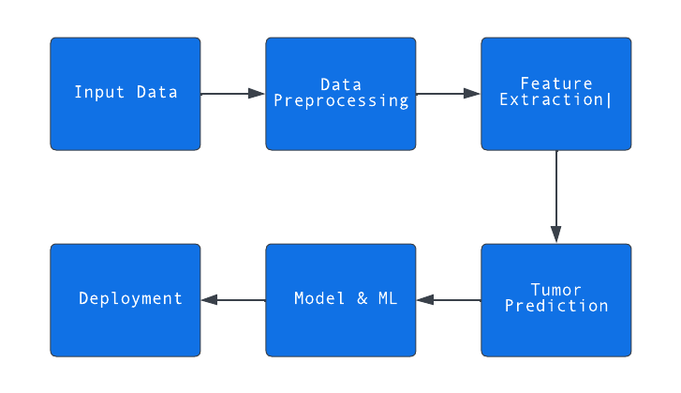
Proposed Architecture/ Diagram:
MIT SCHOOL OF COMPUTING
Class : TY-AIA-1
Group ID :
DEPARTMENT OF COMPUTER SCIENCE & ENGINEERING
Mapping Brain Tumor Progression
Aditya Kulkarni (TY AIA 1 CSE)
Vedashree Bhalerao (TY AIA 1 CSE)
Abstract:
Faculty Guide:
Prof. Shahin Makubhai
This project develops a system using image processing and machine learning to predict brain tumor progression, assisting medical decisions for improved patient care.
P
Objectives
Gather and preprocess brain image data for accurate analysis.
Extract meaningful tumor features through advanced image processing techniques.
Build a robust machine learning model to predict tumor growth rates and stages.
Collaborate with medical experts to refine predictions and enhance clinical relevance.
Problem Statement
Optimizing treatment planning by brain tumor progression stages.
Proposed Solution
Integrating advanced image processing and machine learning, the solution predicts brain tumor growth, aiding informed treatment decisions and enhancing patient care.
Scope and Feasibility
Project leverages imaging and machine learning to predict brain tumor progression bolstered by technology and medical collaboration.

